Slide 1
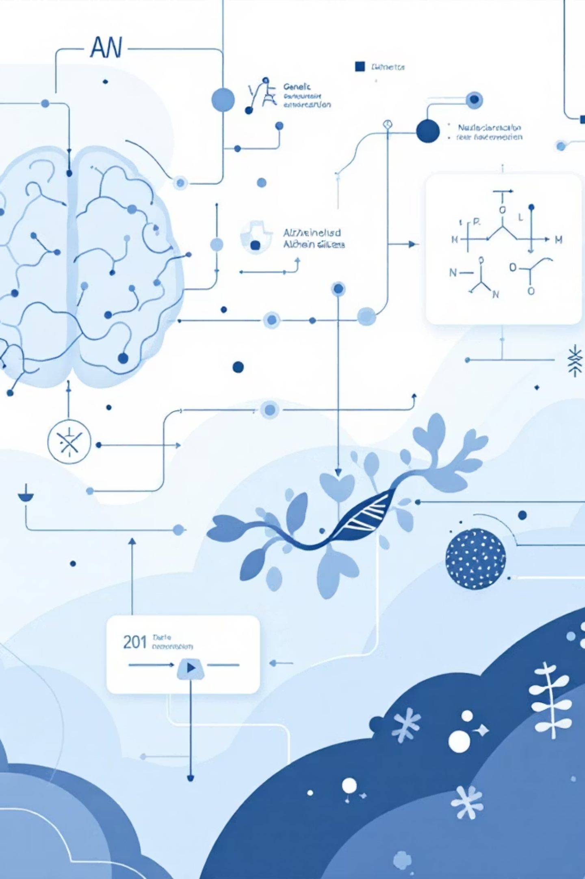

Understanding Alzheimer's Disease: From Biology to Computational Breakthroughs

Slide 2
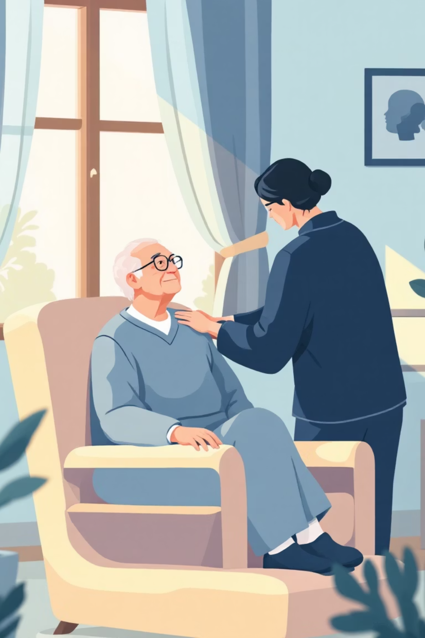
What is Alzheimer's Disease: Prevalence, Symptoms, and Societal Impact
Progressive neurodegenerative disorder.
Destroys memory and cognitive function.
Most common form of dementia (60-80% of cases).
Early symptoms: difficulty remembering, misplacing items, problem-solving challenges.
Begins with mild memory loss and confusion.
Progresses to severe cognitive impairment.
55M
People Affected Globally
Current worldwide prevalence
$1T
Annual Healthcare Costs
Economic burden by 2030
139M
Projected Cases by 2050
Without effective interventions

Slide 3
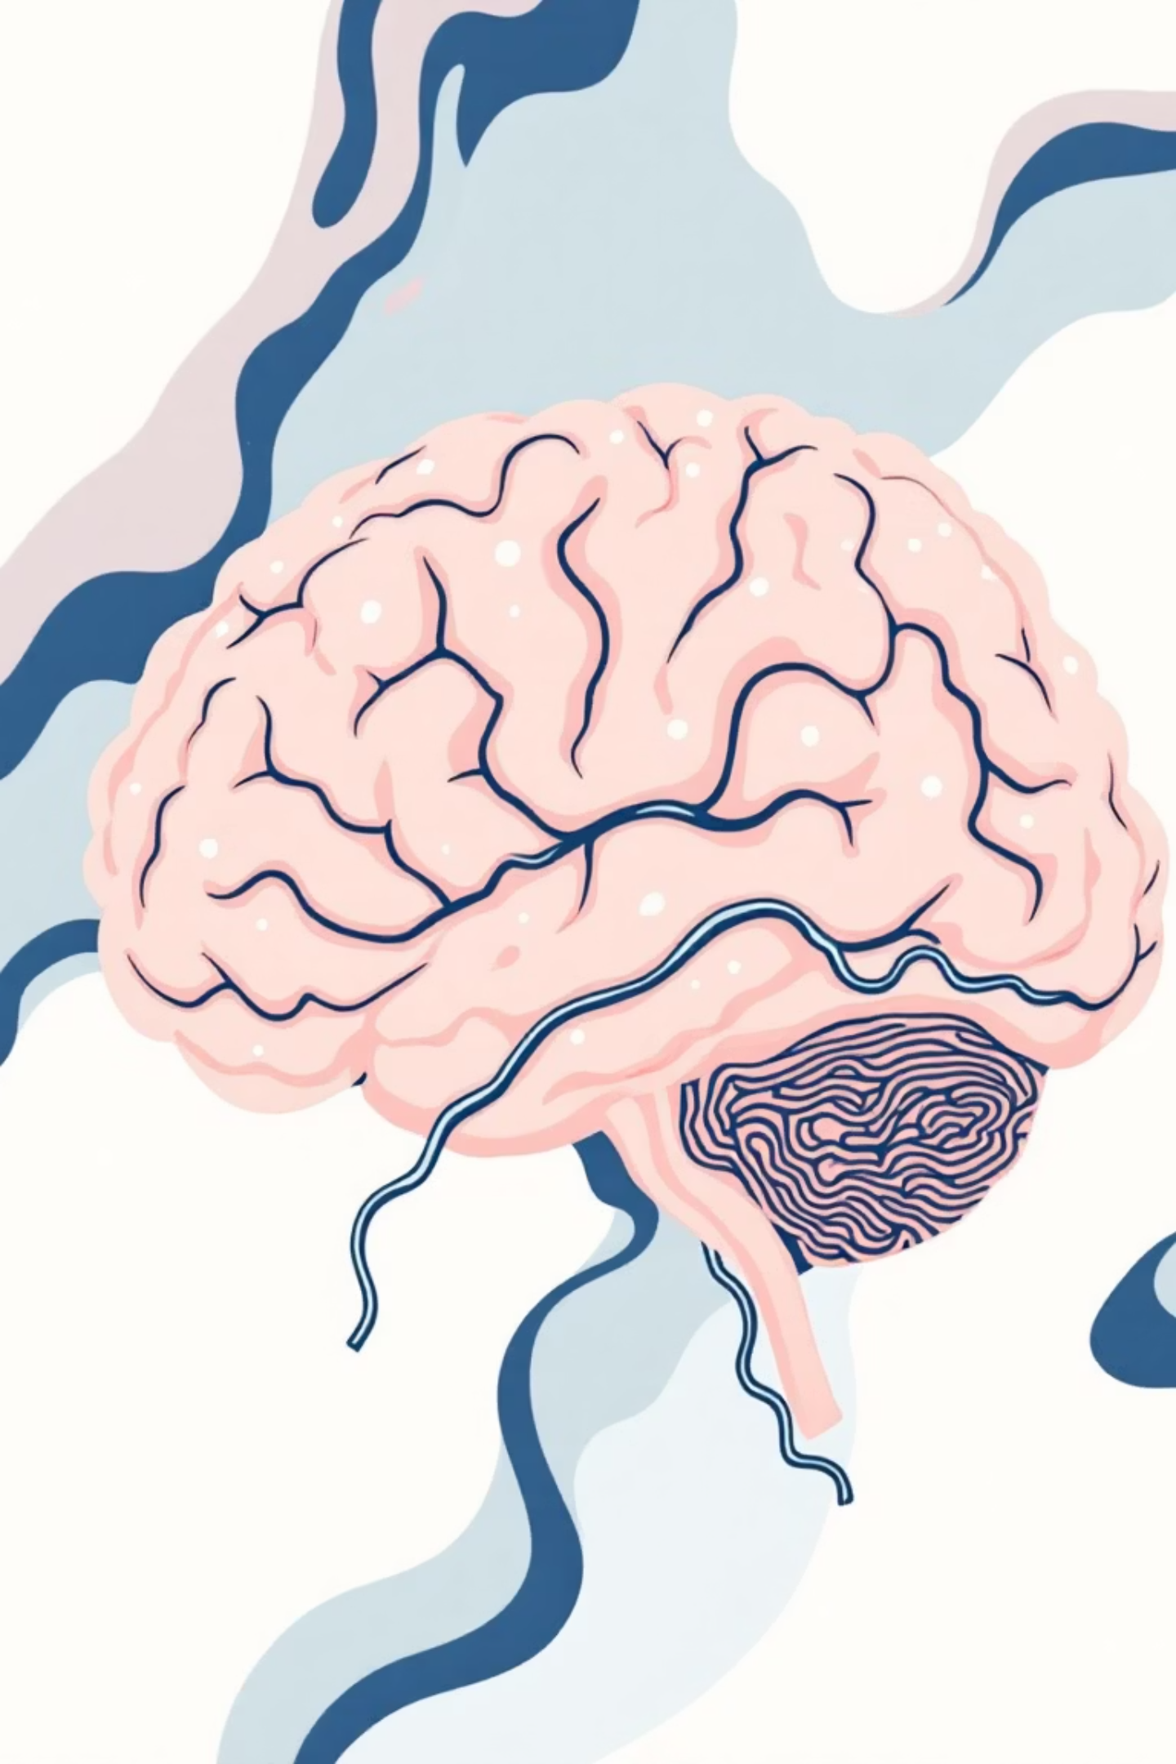
The Molecular Basis: Amyloid Plaques, Tau Tangles, and Neurodegeneration
Alzheimer's is characterized by key protein abnormalities that disrupt brain function and cause widespread neuronal death.
Amyloid-β Plaques
Tau Tangles
Protein fragments accumulate between neurons, disrupting communication.
Tau proteins form twisted fibers inside neurons, blocking essential transport.
Neurodegeneration
Combined toxic effects cause neuronal death, brain shrinkage, and lost connections.

Slide 4
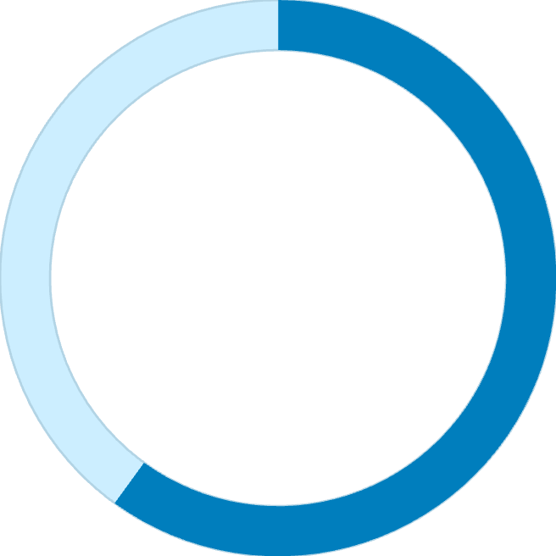
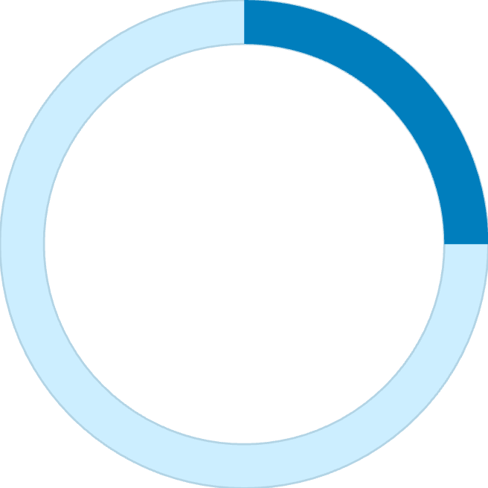
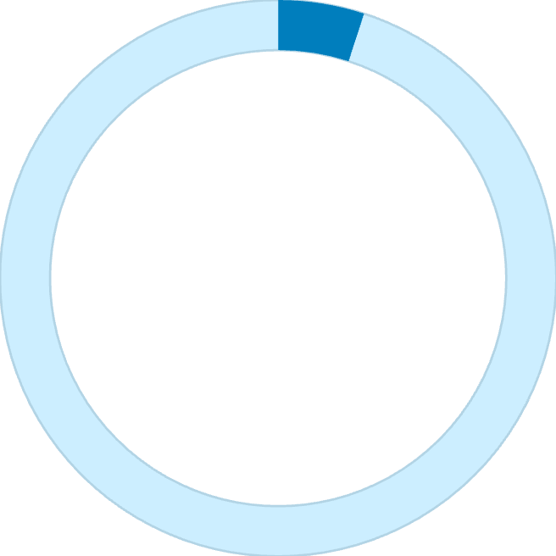
Genetic Factors and Risk Markers
The APOE4 Gene
Familial Mutations
APOE gene variants: ε2, ε3, ε4.
Rare APP, PSEN1, PSEN2 mutations.
APOE4 increases Alzheimer's risk:
Causes early-onset AD.
1 copy: 3x increase.
Develops before age 65.
2 copies: 12x increase.
Autosomal dominant: guarantees disease.
Impairs amyloid-β clearance.
Accounts for <5% of all AD cases.
Found in 40-65% of AD patients.
Provides disease mechanism insights.
Strongest late-onset AD risk factor.
60-80%
25%
5%
Genetic Risk
APOE4 Carriers
Early-Onset AD
Contribution to disease
In general population
Due to familial mutations

Slide 5
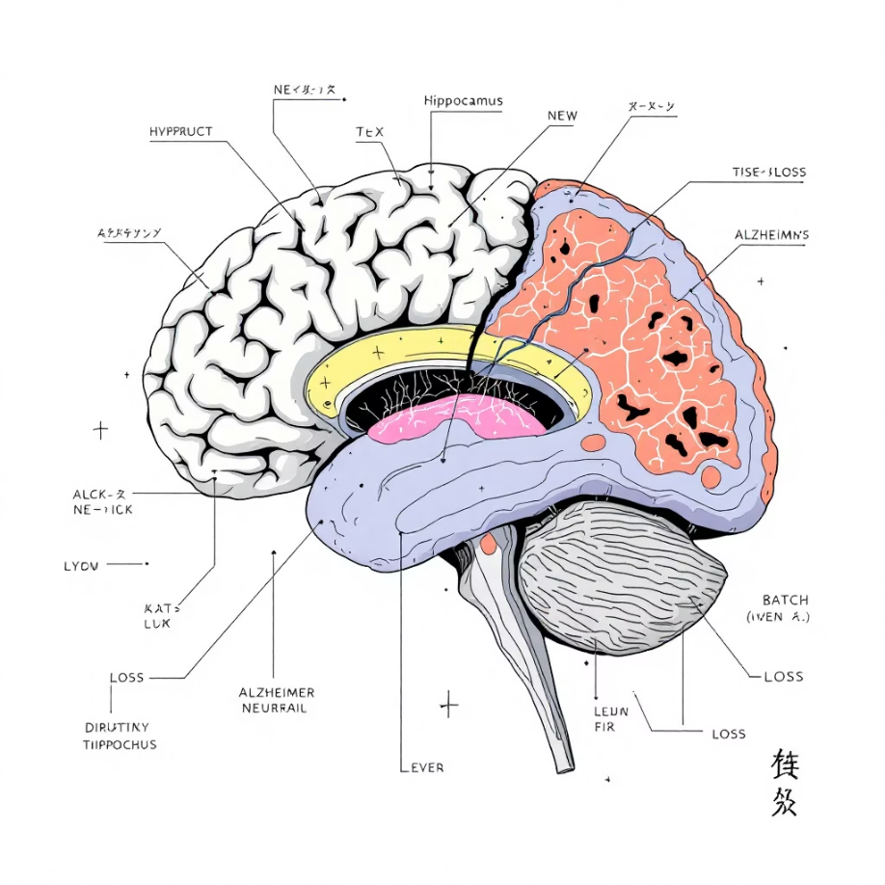
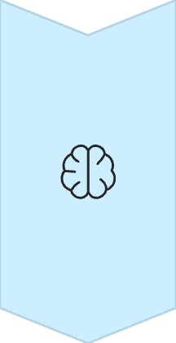
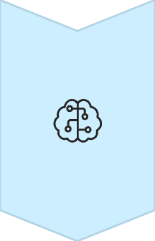
Brain Pathology: Structural Changes, Neural Networks, and Cognitive Decline
Hippocampal Atrophy
Critical for memory.
Earliest, most severe shrinkage.
Up to 25% volume loss.
Network Disruption
Reduced connectivity (default mode & memory).
Tau pathology spreads.
Cognitive Decline
Progressive synapse loss.
Correlates with impairment.
Affects memory, language, spatial reasoning, executive function.
Changes begin in entorhinal cortex & hippocampus.
Spreads to temporal, parietal regions, then cortex.
Brain weight decreases by 30%+.

Slide 6
Current Diagnostic Methods: Biomarkers, Neuroimaging, and Clinical Assessment Tools
Clinical Cognitive Assessment
Structural Brain Imaging
Molecular Imaging
Standardized tests for memory, language, problem-solving.
MRI scans: hippocampal atrophy, cortical thinning.
PET scans visualize amyloid plaques, tau tangles.
MMSE and MoCA provide cognitive profiles.
Track brain tissue loss.
Definitive diagnosis, pathology tracking.
Cerebrospinal Fluid Analysis
Blood-Based Biomarkers
CSF biomarkers: amyloid-β42, total tau, phosphorylated tau.
Plasma tests: phosphorylated tau, amyloid ratios.
Earlier, less invasive screening.
Indicates pathology, often pre-symptomatic.

Slide 7
Computational Modelling: Predicting Disease Progression and Drug Targets
Systems Biology Approaches
Drug Target Identification
Integrates multi-omics data for disease simulation.
Network-based identification of key therapeutic targets.
Multi-scale models track aggregation, neuroinflammation, dysfunction.
Predicts interventions to halt/reverse disease.
Virtual screening of millions of compounds.
Agent-based models simulate amyloid/tau spread.
Accelerates drug candidate discovery.
Biophysical models explore protein misfolding and neuronal death.
Network Medicine
Temporal Modelling
Multi-Target Strategies
Maps protein interactions & signaling.
Predicts disease trajectory from biomarkers.
Identifies drug combinations for multiple pathways.
Reveals disease mechanisms & intervention points.
Personalized prognosis & clinical trial timing.
Potentially higher efficacy than single-target.

Slide 8
Machine Learning Applications: Pattern Recognition in Brain Scans and Genetic Data
AI and ML revolutionize Alzheimer's research by:
Detecting subtle patterns.
Predicting disease outcomes.
Neuroimaging Analysis
Genomic Risk Prediction
Deep learning models distinguish Alzheimer's (90%+ accuracy).
ML algorithms integrate genetic variants.
Identify atrophy patterns years before diagnosis.
Predict individual disease susceptibility.
Progression Forecasting
Subtype Discovery
Models combine clinical, imaging, and biomarker data.
Unsupervised clustering identifies distinct subtypes.
Predict cognitive decline trajectories.
Suggests targeted therapeutic approaches.

Slide 9

AI-Driven Drug Discovery: Virtual Screening, Molecular Dynamics, and Treatment Development
Accelerating Discovery
Virtual Screening
1
AI transforms drug development.
Reduces time & cost.
Screens billions of molecules.
Discovers novel molecules (e.g., tau aggregation targets).
Repurposes existing drugs.
AI candidates in clinical trials.
Accelerates patient access.
Predicts compound-protein interactions.
2
Molecular Dynamics
Simulates atomic interactions; predicts binding, stability, side effects.
Lead Optimisation
3
Refines drug candidates; optimizes properties.
4
Clinical Trial Design
Identifies optimal patients, predicts responses, designs trials.

Slide 10
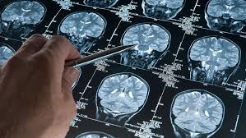
Future Directions: Digital Biomarkers, Precision Medicine, and Collaborative Research Initiatives
Precision Medicine
Digital Biomarkers
Genetic & biomarker profiles
Wearables & smartphone apps
Personalised treatment selection
Monitor cognition, sleep, activity
Match patients to therapies
Detect disease progression
Data Sharing Consortia
Global data pooling
Clinical, imaging, omics data
Accelerate discovery
Prevention Strategies
Intervene before symptoms
Multi-Modal Therapies
Lifestyle & preventive treatments
Combination approaches
AI screening for at-risk individuals
Target multiple pathways
Models predict synergy & dosing
"The convergence of computational biology, artificial intelligence, and collaborative big data science represents our greatest hope for conquering Alzheimer's disease. We stand at the threshold of transformative breakthroughs that will fundamentally change how we prevent, diagnose, and treat this devastating condition."

